Slide 1
Chongqing University of Technology
ATAI
Advanced Technique of Artificial Intelligence
Chongqing Unive
Deep Context- and Relation-Aware Learning
for Aspect-based Sentiment Analysis
（ACL-2021)
Reported by Zicong Dou
Notes:
基于方面情感分析的深度上下文和关系感知学习

Slide 2
Chongqing University of Technology
ATAI
Advanced Technique of Artificial Intelligence
Chongqing University of Technology
1. Introduction
2. Approach
3. Experiments
4. Conclusion

Slide 3
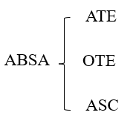
Introduction
ABSA tends to predict polarities based on the literal meaning of aspect and opinion terms and mainly consider relations implicitly among subtasks at the word level. In addition, identifying multiple aspect–opinion pairs with their polarities is much more challenging.
To address the aforementioned issues, we propose Deep Contextualized Relation-Aware Network (DCRAN) for ABSA.

Slide 4
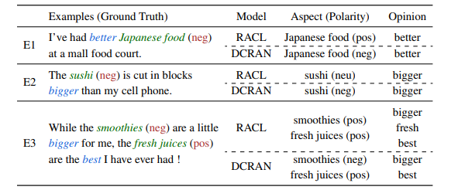
Introduction

Slide 5
Introduction
DCRAN not only implicitly allows interactive relations among the subtasks of ABSA, but also explicitly considers their relations by using contextual information.
• (1) We design aspect and opinion propagation decoder so that the model has a comprehensive understanding of the whole context, and thus it results in better prediction of the polarity.
• (2) We propose novel self-supervised strategies for ABSA, which are highly effective in dealing with multiple aspects and considering deep contextualized information with the aspect and opinion terms.
Notes:
我们提出了用于ABSA的深度上下文化关系感知网络(DCRAN)。
DCRAN不仅隐式地允许ABSA子任务之间的交互关系，而且通过上下文信息明确地考虑它们之间的关系。
(1)我们设计了方面和观点传播解码器，使模型对整个上下文有一个全面的理解，从而更好地预测极性。
(2)我们提出了新的ABSA自监督策略，该策略在处理多个方面和考虑方面和观点术语的深度上下文化信息方面非常有效。

Slide 6
Approach
S = {w1, w2, ..., wn}
ATE:
OTE:
ASC:

Slide 7
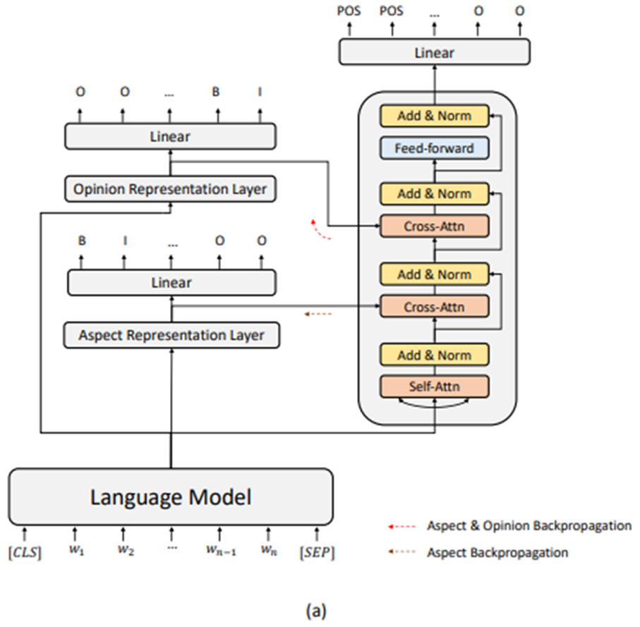
Approach

Slide 8
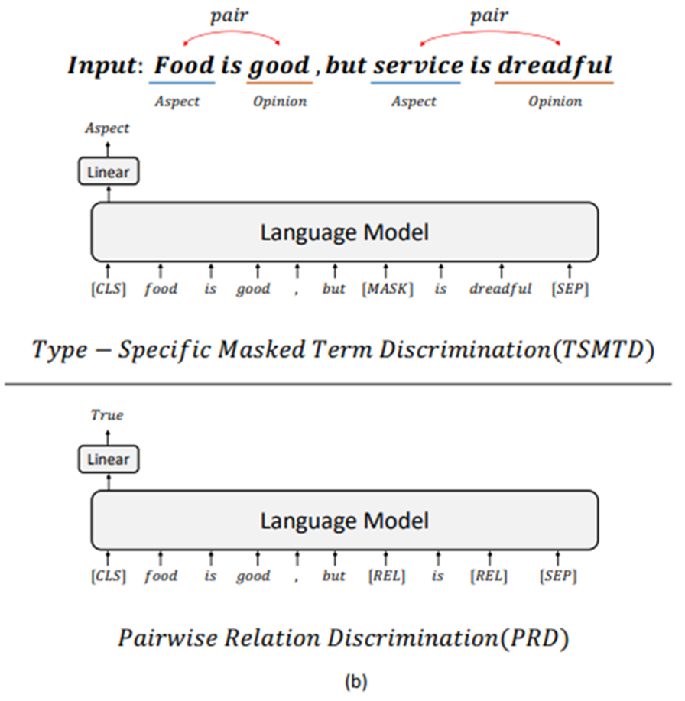
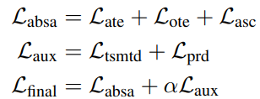
Approach

Slide 9
Experiments

Slide 10
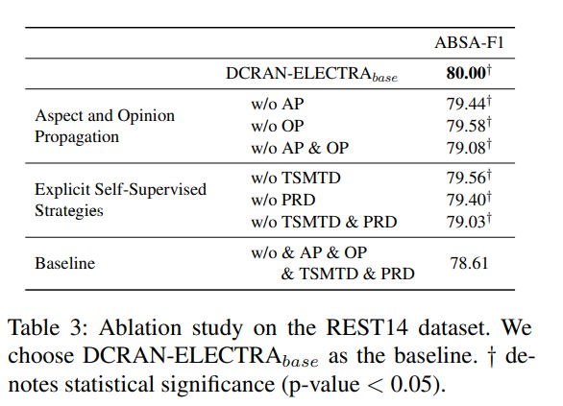
Experiments

Slide 11
Experiments

Slide 12
Conclusion
In this paper, we proposed the Deep Contextualized Relation-Aware Network (DCRAN) for aspect based sentiment analysis. DCRAN allows interaction between subtasks implicitly in a more effective manner and two explicit self-supervised strategies for deep context- and relation-aware learning. We obtained the new state-of-the-art results on three widely used benchmarks.
Notes:
在本文中，我们提出了用于基于方面的情感分析的深度上下文关系感知网络（DCRAN）。DCRAN允许子任务之间以更有效的方式进行隐性互动，并为深度上下文和关系感知学习提供两种明确的自我监督策略。我们在三个广泛使用的基准上获得了新的最先进的结果。

Slide 13
Thank you!

